Slide 1
Hospitals And COVID In Los Angeles County
Bofan Chen

Slide 2
Introduction
In difficult public health circumstances, supplies may become scarce, and communities may not be affected equally. Looking at a range of demographic, public health, and hospital data may allow decision-makers to create informed plans about how to mobilize medical resources in a targeted fashion.
In more regular times, certain regions may still be underserved with regards to their healthcare
needs. Geospatial analysis can also help determine which areas may benefit most from a newly constructed hospital or increased medical staffing.

Slide 3
Goals
This capstone project for the Coursera-IBM Data Science Certificate will explore hospital data by cities in Los Angeles County, as well as COVID case data in the region between mid-December 2020 to mid-January 2021.
More specifically, this assignment tries to analyze data in two areas.
1. Which zip codes in LAC are located furthest away from the nearest medical center, as found by Foursquare, and would therefore perhaps benefit most from a new hospital.
2. Which cities in LAC have the highest ratios of COVID cases to hospital beds, and could require increased medical assistance in the near future; as well as which cities in LAC have the highest ratios of people to hospital beds, and may benefit from increased hospital capacities in the longer term.

Slide 4
Data Los Angeles County Cities And Populations
A list of cities that make up LAC, and their populations, was provided by Wikipedia.
List of cities in Los Angeles County, California – Wikipedia
Features include
City Name
Data City Was Incorporated Into County
City Population As Of 2010 US Census
This data spans 88 cities in LAC.

Slide 5
Data US Zip Codes
A list of zip codes that make up the US, including a handful of other features, was compiled by Schuyler Erle at Geocoder, and provided by Civic Space Labs.
download – CivicSpace Labs
Features include
Zip Code
City
State
Longitude
Latitude
Time Zone
Observance Of Daylight Savings Time
Zip codes were filtered so all matched up to a city in LAC. This filtered data spans 404 zip codes in 75 cities in LAC.

Slide 6
Data Los Angeles County Healthcare Facility Beds
A list of California state healthcare facilities and number of beds, among several other features, was provided by the California Health And Human Services Open Data Portal.
Licensed Healthcare Facility Listing - Licensed Healthcare Facility Listing, December 31, 2020 - California Health and Human Services Open Data Portal
Filtered features include
Facility Name
City
Zip Code
Number Of Beds
Latitude
Longitude
Facilities were filtered to include only those that were located in LAC, are currently open, and have a specified number of beds. This filtered data spans 625 healthcare facilities across LAC.

Slide 7
Data Los Angeles County COVID Cases
A list of daily-updated cumulative COVID case counts for California state since 20200228 was provided by the Los Angeles Times.
california-coronavirus-data/latimes-place-totals.csv at master · datadesk/california-coronavirus-data (github.com)
Filtered features include
Date
City
Confirmed Cases So Far
Data points from LAC on 20201215 and 20210115 were taken to calculate the number of new cases in the past 30 days in the county as of 20210115.
Cities not in Wikipedia's LAC city list were assumed to be neighborhoods in Los Angeles City, and their cases were summed.
This final data spanned 85 LAC cities.

Slide 8
Data Foursquare
Foursquare venue data was accessed to retrieve the 50 closest hospitals, hospital wards, emergency rooms, and urgent care centers within 100,000 meters of the centers of each zip code in LAC. Duplicate venues were removed.
Features extracted from the JSON data were
Venue Name
Zip Code
City
Latitude
Longitude
Venue Type
Data points that did not include zip codes and/or cities were labelled to the closest zip codes based on latitude and longitude, and mapped to the corresponding cities.
This data only spanned 209 healthcare facilities, compared to 625 from the earlier bed data set.

Slide 9
Data GeoJSON
Los Angeles County zip code boundaries were provided, again, by the Los Angeles Times. These were used when visualizing data in Folium maps.
Mapping L.A. Boundaries API - Data Desk - Los Angeles Times (latimes.com)

Slide 10
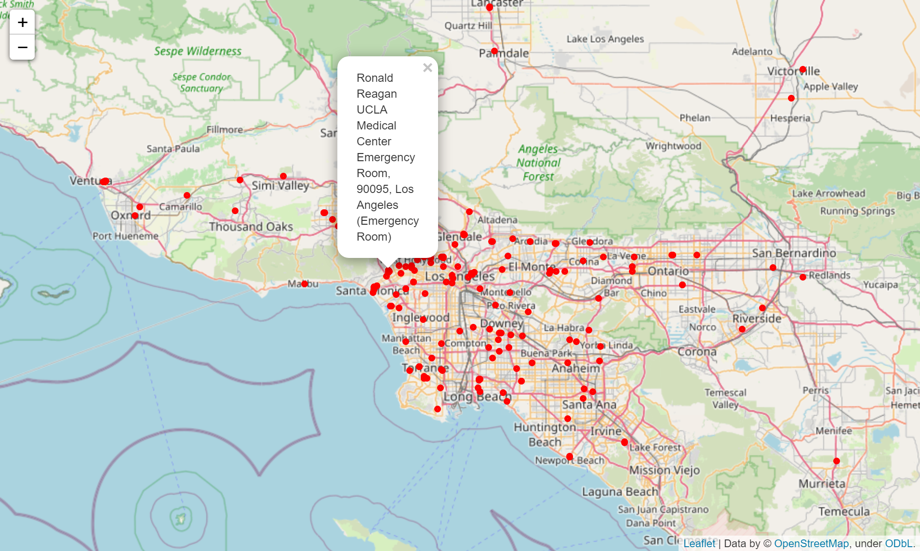
Foursquare
A map of medical centers located by Foursquare.
The majority of health care facilities in LAC are situated near the center of the region. Areas in the more rural, outer reaches of the county, with smaller populations and fewer roads, may benefit from increased healthcare infrastructure.

Slide 11
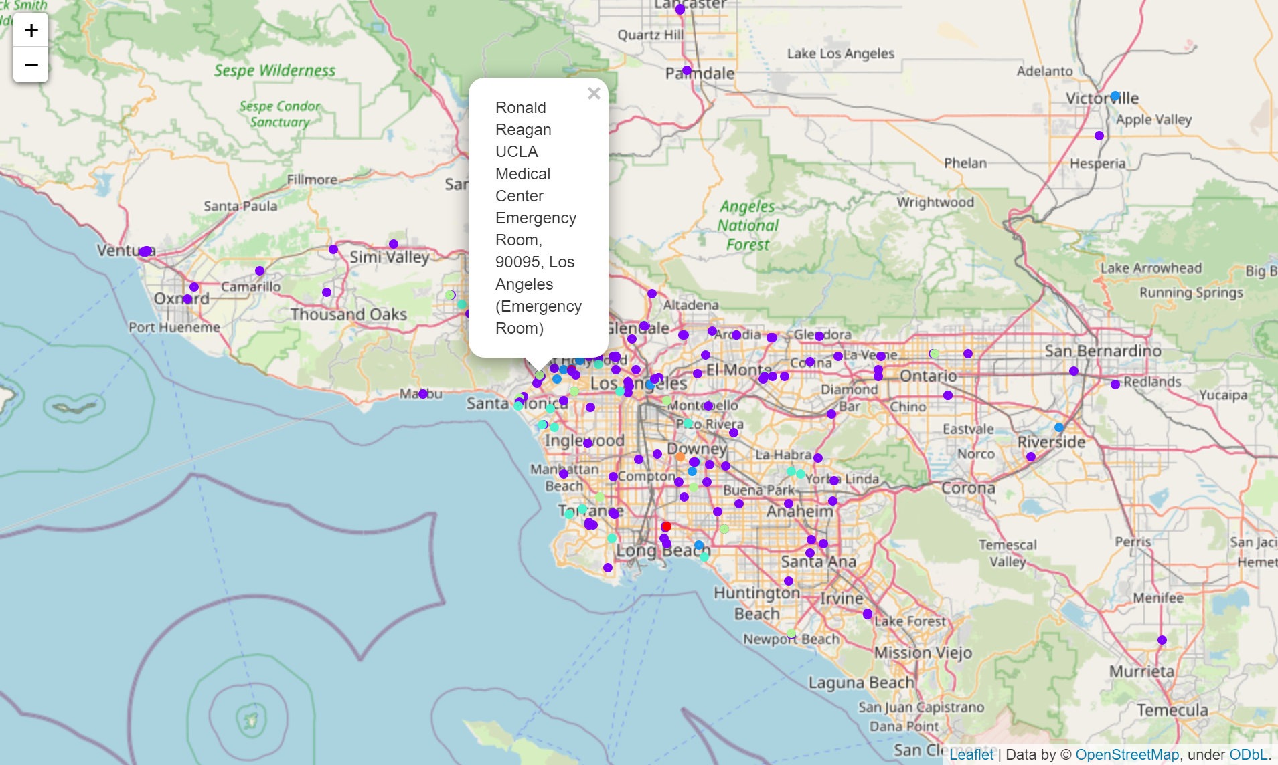
Foursquare
In the above color-coded map, purple dots indicate hospitals, blue dots medical centers (general), light green dots emergency rooms, and turquoise dots urgent care centers. The red dot is a hospital ward and the orange dot an office.

Slide 12
Foursquare
The LAC zip codes furthest from the nearest medical center, according to Foursquare venue data, are 91359, 91361, 90704, 90265, 91301, 93536, 90263, 91302, 91711, and 91767.

Slide 13
Beds
The following table shows the top 5 cities in LAC in terms of new COVID cases between 20201215-20210115 per hospital bed.
City | COVID Cases | Medical Facility Beds | Cases/Bed
South Gate | 6916 | 99 | 69.86
Compton | 6174 | 99 | 62.36
Calabasas | 336 | 6 | 56
Palmdale | 8468 | 214 | 39.57
Azusa | 2194 | 65 | 33.75

Slide 14
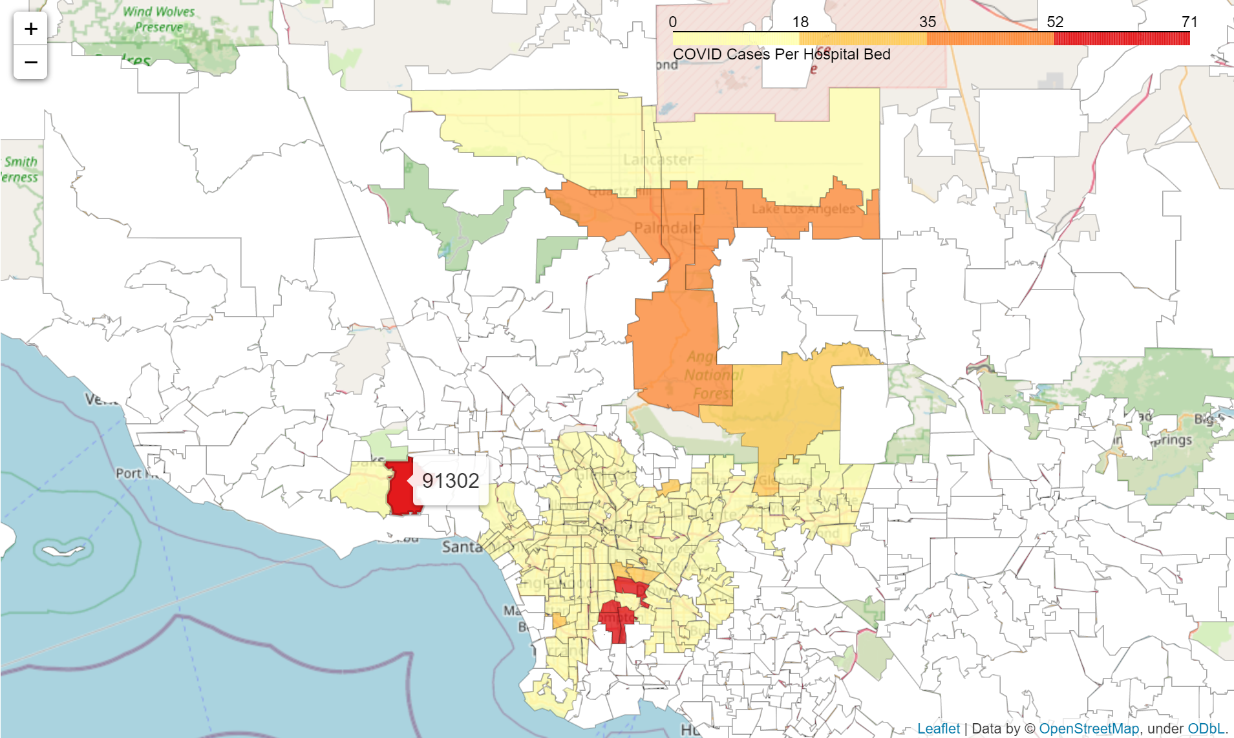
Beds
Zip codes 90220-90223, 90280, and 91302 have the most COVID cases per hospital bed. These correspond to the cities of Compton, South Gate, and Calabasas.

Slide 15
Beds
The following table shows the top 5 cities in LAC in terms of people per hospital bed.
City | Population (2010) | Medical Facility Beds | People/Bed
Calabasas | 23058 | 6 | 3843
San Marino | 13147 | 6 | 2191.17
Rancho Palos Verdes | 41643 | 34 | 1224.79
Agoura Hills | 20330 | 20 | 1016
Compton | 96455 | 99 | 974.29

Slide 16
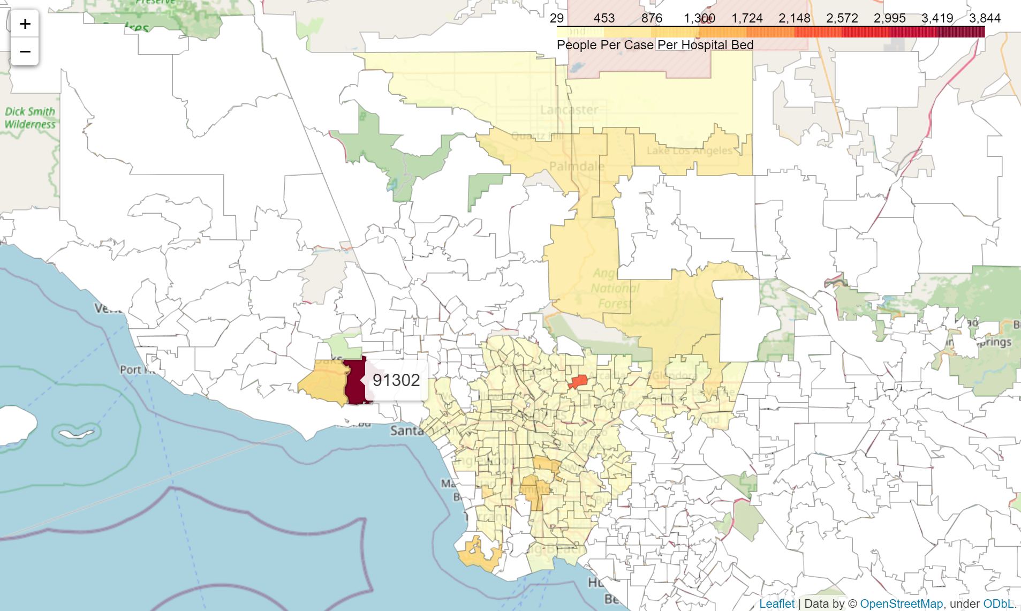
Beds
Zip codes 91302, 91108, and 90275 have the highest ratios of people in the general population for each hospital bed. These correspond to the cities of Calabasas (again), San Marino, and Rancho Palos Verdes.

Slide 17
Issues
A major obstacle, and a huge liability in the project results, is the lack of consistency across data from each of the sources used. Between the medical bed data and the Foursquare venue data, facility names were formatted differently, with bed data being in all-caps and occasionally including city names at the end. Latitude and longitude coordinates between the two data sets often had differing levels of precision, and sometimes pointed to separate areas. Foursquare venue data was also unable to capture the complete set of facilities included in the bed data provided by the California government.

Slide 18
Issues
The numbers of beds counted for certain communities were suspicious, like having only 6 beds for the top two cities in terms of ratio of people per bed, Calabasas and San Marino.
In addition, different data sets separated LAC in different ways. Some split Los Angeles city into separate neighborhoods of more comparable population sizes to the other cities in the county; others didn't. Furthermore, zip code boundaries sometimes don't match up with city boundaries, furthering complicating matters.
Lastly, the GeoJSON file included a number of cities in Orange County to the southeast of LAC, potentially among other areas not within LAC.

Slide 19
Conclusion
Geospatial data analysis can be useful in issues of public concern, in addition to solving business problems. Combined with resource data, location info can be employed to help more efficiently provide access to government, or other, supplies.
As a general result reached by this project, many remote and underserved communities may require better access to healthcare resources to bolster their responses to public health crises and maintain higher qualities of care for their populations even in the absence of severe outbreaks.
In the future, more well-documented data sets across entities could help provide better analyses. This could include standardized naming conventions, standardized county sub-divisions, and greater precision in geospatial coordinates, among other features. Organizations that collaborate and coordinate their data collection and formatting can create higher quality data that is more comprehensive and can yield more useful results.

Slide 20
Thank You!

